Slide 1
War Casualties (1989-2022)

Slide 2
Description
Data Source: https://ourworldindata.org/war-and-peace
The source is reliable since it’s trusted by major companies:
The Washington post
Wall Street Journal
Royal Statistical Society
Harvard University

Slide 3
Data Cleaning
Deleted Column: “Code”
It was redundant.
USA or AFG
Notes:
because the “Country” column already tells us the name.

Slide 4
Questions
Which country had the highest deaths in 2001?
How many total deaths were in Afghanistan during 2003 – 2006?
How did the Somalian Civil casualties change between 1991 and 2021?
How many Russian and Ukraine casualties were there in total from 2021-2022?
What are the top 5 deadliest years and their corresponding countries based on the number of deaths?

Slide 5
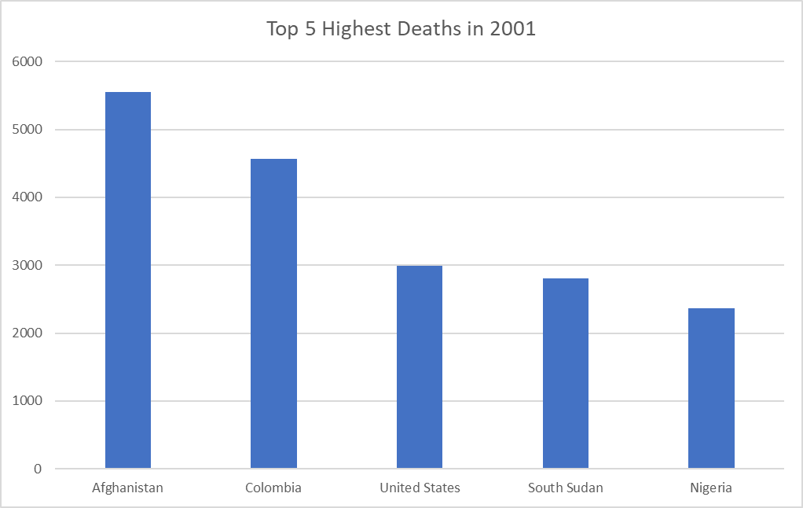
Which country had the highest deaths in 2001?
SELECT * FROM `WarData` WHERE Year = 2001 ORDER BY `Deaths in ongoing conflicts` DESC;
Answer:
Afghanistan

Slide 6
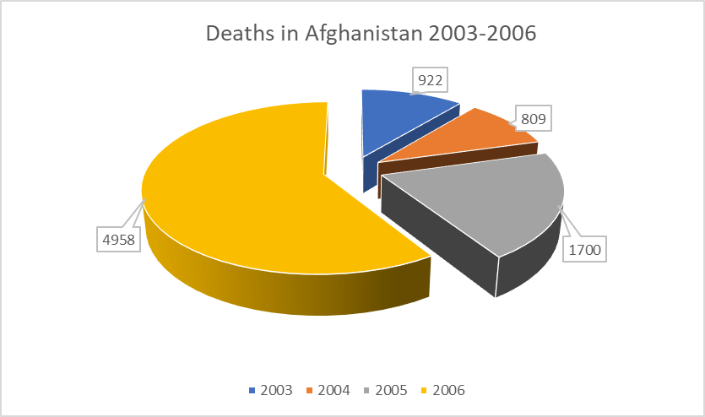
How many total deaths were in Afghanistan during 2003 – 2006?
SELECT SUM(Deaths) FROM `WarData` WHERE (Year BETWEEN 2003 AND 2006) AND Entity = "Afghanistan"
Answer: 8389 Total Deaths

Slide 7
How did the Somalian Civil casualties change between 1991 and 2021?
SELECT * FROM WarData WHERE (Entity = 'Somalia') AND (Year = 1991 OR Year = 2021)
Answer: 73.23% decrease
(6196 decrease in deaths)

Slide 8
How many Russian and Ukraine casualties were there in total from 2021-2022?
SELECT SUM(Deaths) FROM WarData WHERE (Entity = 'Russia' OR Entity = 'Ukraine') AND (Year = 2022 OR Year = 2021)
Answer: 82,866 total deaths from both countries.

Slide 9
What are the top 5 deadliest years and their corresponding countries based on the number of deaths?
Rwanda-1994
Ethiopia-2022
Ukraine-2022
Syria-2014
Syria-2013
SELECT * FROM WarData ORDER BY Deaths DESC LIMIT 5;

Slide 10
SQL Queries & Results
SELECT * FROM `WarData` WHERE Year = 2001 ORDER BY `Deaths in ongoing conflicts` DESC;
SELECT SUM(Deaths) FROM `WarData` WHERE (Year BETWEEN 2003 AND 2006) AND Entity = "Afghanistan"
SELECT * FROM WarData WHERE (Entity = 'Somalia') AND (Year = 1991 OR Year = 2021)
SELECT SUM(Deaths) FROM WarData WHERE (Entity = 'Russia' OR Entity = 'Ukraine') AND (Year = 2022 OR Year = 2021) SELECT * FROM WarData ORDER BY Deaths DESC LIMIT 5;

Slide 11
Conclusion
We learned about the number of casualties between:
1989–2022 & Different countries
The SQl queries posed a challenge, but through persistence and teamwork, we overcame the obstacle.
We would make these changes:
Come up with more meaningful questions
A more dynamic and polished presentation

